Slide 1


Unveiling India's Literacy Landscape
India's literacy landscape is a tapestry of progress and challenges. From bustling cities to remote villages, the nation's educational achievements and disparities are interwoven, reflecting the complexities of its diverse population and the ongoing efforts to ensure universal access to knowledge.

Slide 2
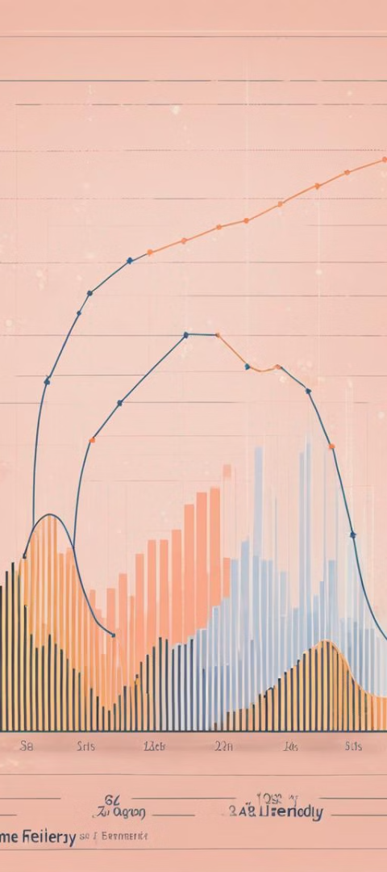
HISTORICAL TRENDS IN INDIAN LITERACY RATES
1
2001
In 2001, India's literacy rate was approximately 64.84%. This figure represented the percentage of individuals aged 15 and above who could read and write in any language. However, India's literacy rate varied significantly across regions and demographic groups.
2
2011
In 2011, India's literacy rate was approximately 74.04%. This figure
represented the percentage of individuals aged 7 and above who
could read and write in any language. Similar to previous years,
literacy rates varied across regions and demographic groups in India.

Slide 3
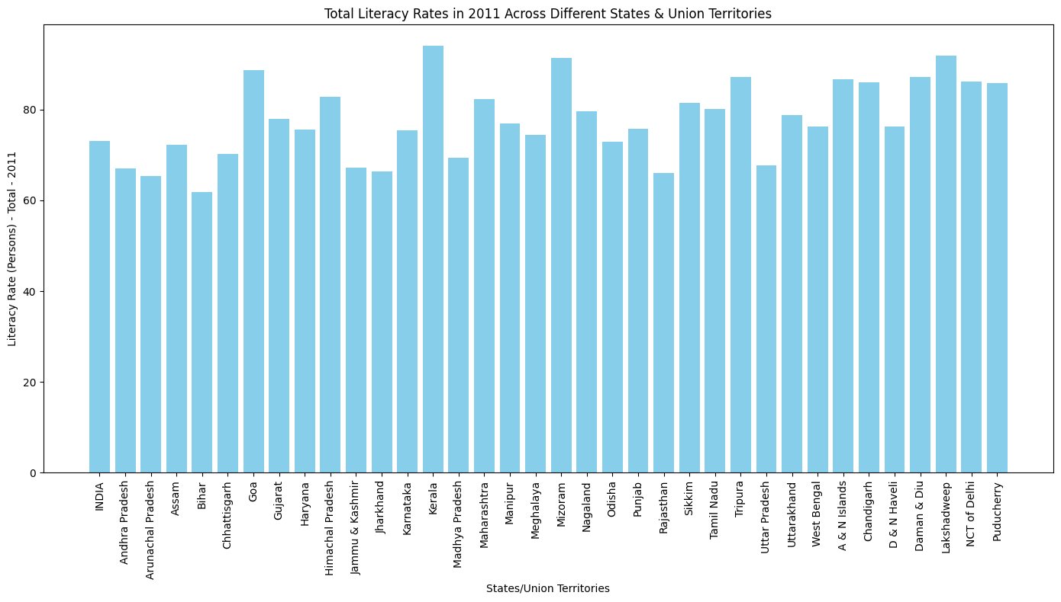
REGIONAL DISPARITIES IN LITERACY LEVELS
High Literacy States
Low Literacy States
Gender Imbalance
Kerala, Delhi, and Himachal Pradesh lead with literacy rates above 80%.
Rajasthan, Uttar Pradesh, and Bihar struggle with literacy rates below 70%.
The gender gap in literacy remains significant, with lower rates for women in many states.

Slide 4
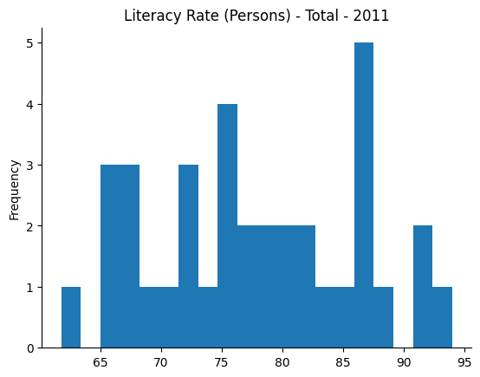
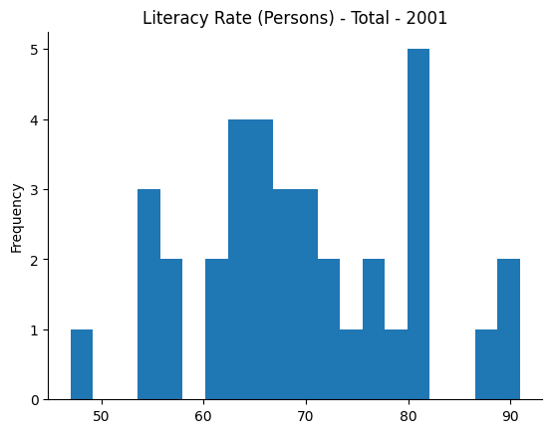


OVERVIEW OF LITERACY RATES
.

Slide 5
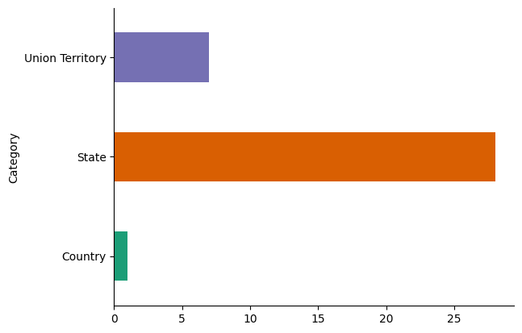
DATA CATEGORY BY STATE, UNION TERRITORY, COUNTRY

Slide 6
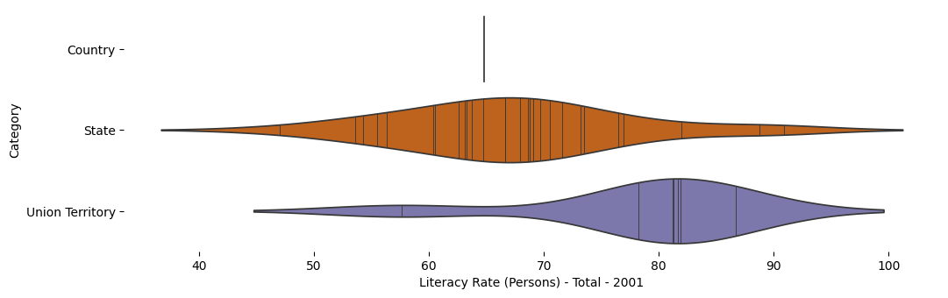
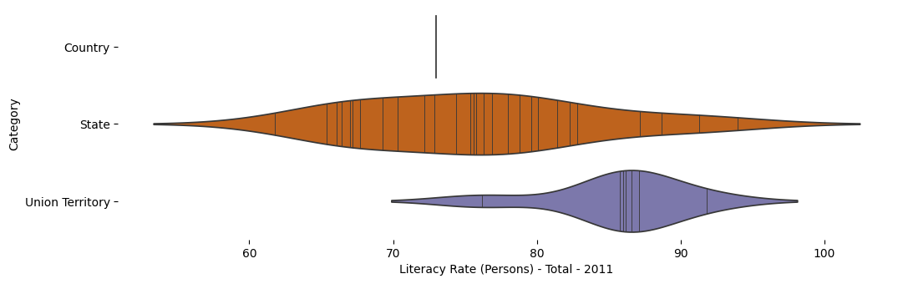
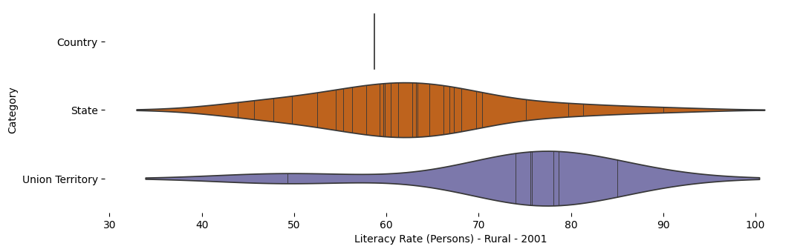
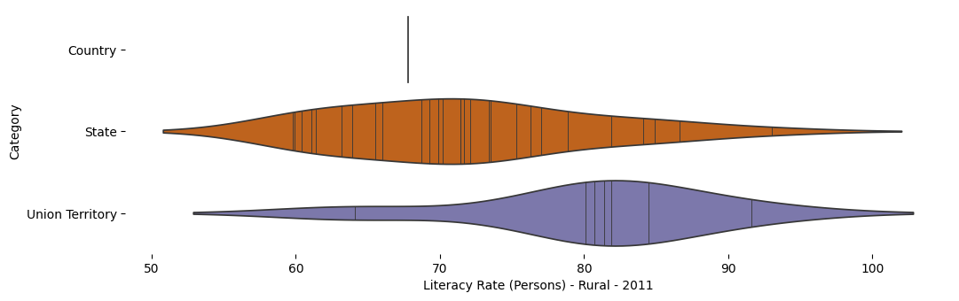
DATA CATEGORY VIOLIN PLOTS

Slide 7
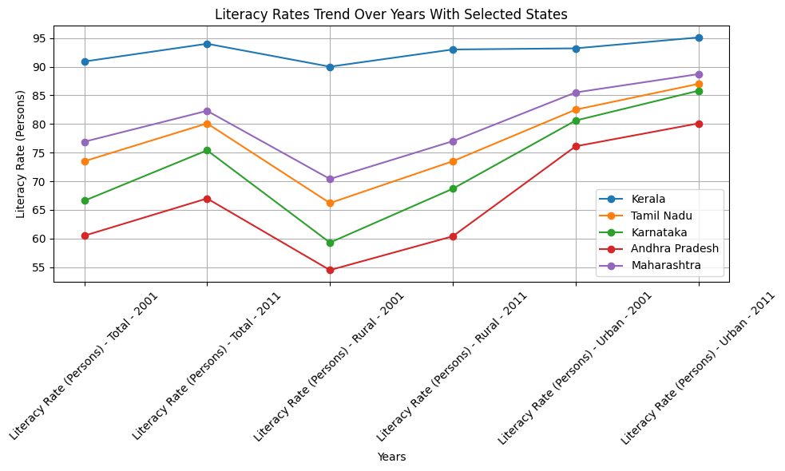
LITERACY RATES TREND OVER YEARS WITH SELECTED STATES

Slide 8
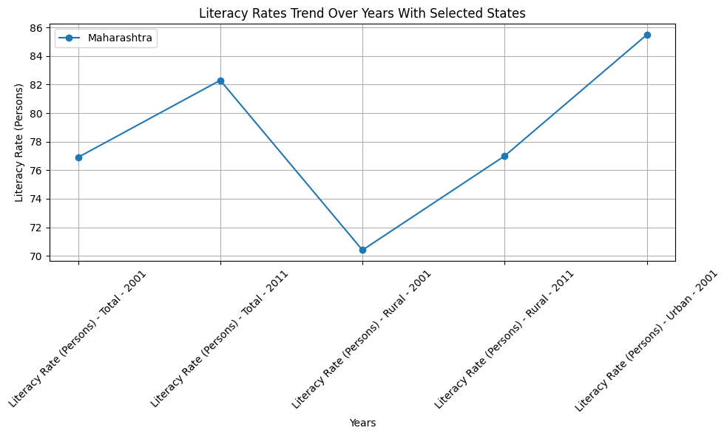
LITERACY RATES TREND OVER YEARS WITH SELECTED STATES

Slide 9


LETS FIND HIGHEST & LOWEST
HIGH LITERACY STATES
LOW LITERACY STATES
Kerala - Literacy Rate: 94.0%
Lakshadweep - Literacy Rate: 91.8%
Mizoram - Literacy Rate: 91.3%
Goa - Literacy Rate: 88.7%
Tripura - Literacy Rate: 87.2%
Bihar - Literacy Rate: 61.8%
Arunachal Pradesh - Literacy Rate: 65.4%
Rajasthan - Literacy Rate: 66.1%
Jharkhand - Literacy Rate: 66.4%
Andhra Pradesh - Literacy Rate: 67.0%

Slide 10
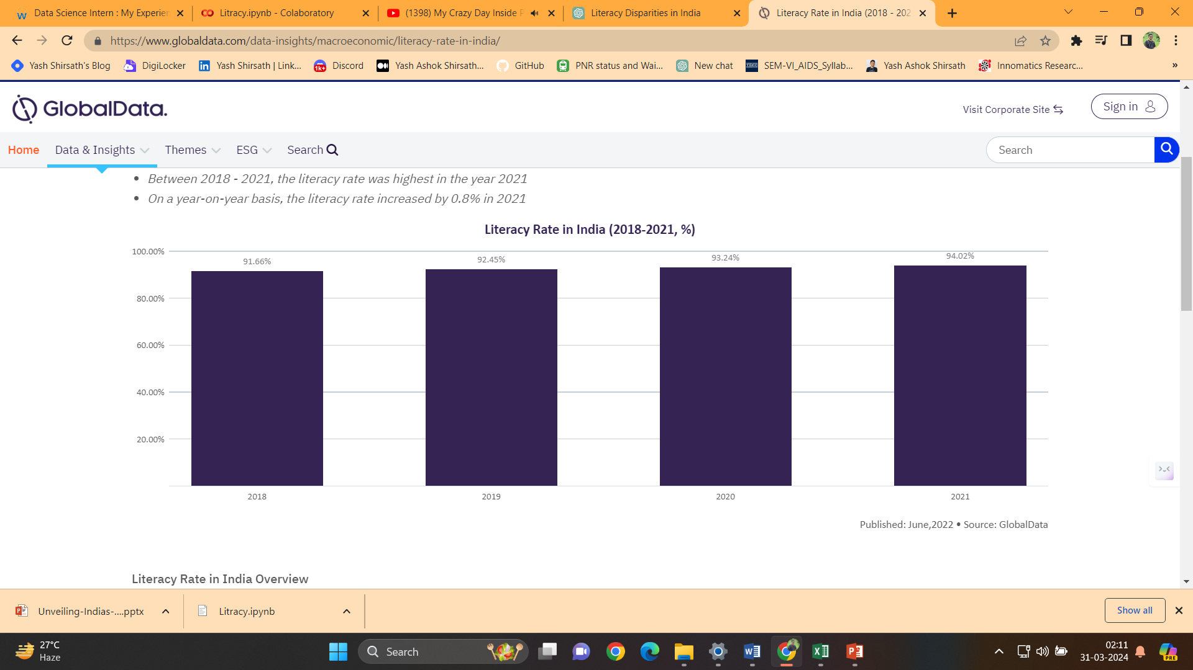
LITERACY RATE IN INDIA (2018 - 2021, %)
The literacy rate in India reached 94.02% in 2021
Between 2018 - 2021, the literacy rate was highest in the year 2021
On a year-on-year basis, the literacy rate increased by 0.8% in 2021

Slide 11
CONCLUSION
Regional Disparities: There are significant disparities in literacy rates across different states and union territories. While some regions exhibit high literacy rates, others struggle with low literacy rates.
High Literacy States: States such as Kerala, Lakshadweep, Mizoram, Goa, and Tripura stand out for their high literacy rates in 2011. These states serve as examples of successful educational policies and programs that have led to widespread literacy.
Low Literacy States: Conversely, states like Bihar, Arunachal Pradesh, Rajasthan, Jharkhand, and Andhra Pradesh have lower literacy rates, indicating challenges in providing access to quality education and addressing socio-economic barriers to learning.
Gender Imbalance: The analysis also highlights gender imbalances in literacy rates, with some states exhibiting significant disparities between male and female literacy rates. Addressing these imbalances is crucial for achieving gender equality and ensuring inclusive educational opportunities for all.
Importance of Literacy: Overall, literacy plays a pivotal role in social and economic development. It empowers individuals, improves health outcomes, reduces poverty, and fosters economic growth. Therefore, efforts to improve literacy rates, particularly in low-performing regions and among marginalized populations, are essential for advancing sustainable development goals.
Continued Efforts Needed: While progress has been made in improving literacy rates nationwide, there is still much work to be done. Government initiatives, community engagement, and targeted interventions are necessary to address the underlying factors contributing to low literacy rates and promote lifelong learning opportunities for all citizens.
By understanding the current state of literacy in India and identifying areas for improvement, policymakers, educators, and stakeholders can work together to implement effective strategies and initiatives that promote universal access to quality education and enhance literacy outcomes for all individuals.

